Slide 1
NTT PRESENTS · YUVA '26
SRMIST TIRUCHIRAPPALLI
VIBECRAFT 2026
Hands-on vibe-coding hackathon with AI tools under real-time pressure.
Teams of 2–4
28 September 2026
4th Floor Venue

Slide 2


EVENT CONCEPT
Not Your Usual Hackathon
Fast-Paced Execution
AI-Assisted Building
Dual Competency
Sharp time pressure forcing real prioritization calls.
Leverage modern AI tools for accelerated development.
Technical skill and pressure management evaluated together.

Slide 3
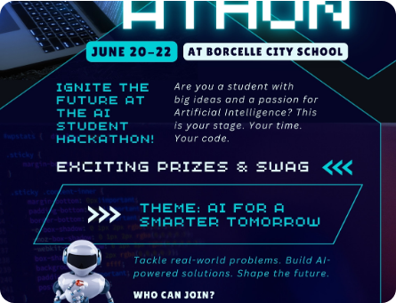
GROUND RULES
Core Participation Guidelines
01
Team Size Structure
2–4 members per team. No solo entries.
02
Bring Your Own Device
Laptops and software tools pre-configured before Round 1.
03
Offline On-Site Execution
100% offline participation on the 4th Floor venue.

Slide 4
EVENT FLOW
Three Sequential Stages
STAGE 01
STAGE 02
STAGE 03
Round 1: Open Entry
Round 2: Tech & Data
Round 3: Grand Finale
All registered teams compete simultaneously.
Dataset integration and rapid prototyping.
Final solution showcase and jury evaluation.

Slide 5
ASSESSMENT METRICS
How Teams Are Judged
Problem Relevance
Solution Feasibility
Direct alignment with problem statement.
Practical technical implementation.
Dataset Utilization
UX & Design Quality
Effective integration of provided data.
Clean interface design and usability.

Slide 6
BALANCED EVALUATION
Dual Competency Focus
Core coding & system building.
Boosts team standing in next round.
Technical Tasks
Non-Technical Tasks
Primary score weightage.
Bonus edge modifier.

Slide 7
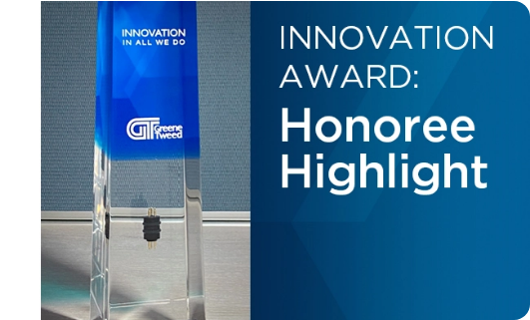
REWARDS
Prizes & Industry Backing
₹10,000
Total Prize Pool
Tech Credits
Certificates
Special partner tool goodies.
Backed by startups & partners.

Slide 8
TEAM PLAY
Maximizing Team Efficiency
Pre-Assign Roles
Continuous Velocity
Full Participation
Sort duties before clock starts.
No pause buttons for huddles.
Sitting out tasks penalizes score.

Slide 9
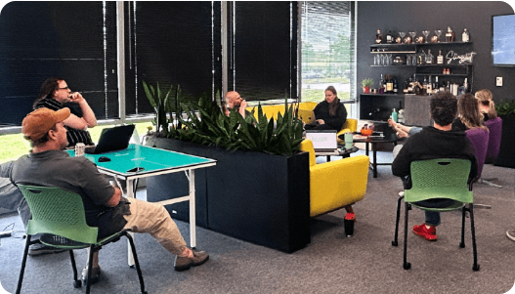

THE CREW
Neuro Tech Titans (NTT)
Naren Karthik R
President · Neuro Tech Titans
Driving VibeCraft Season 1 innovation vision.

Slide 10


INSTITUTIONAL BACKING
Collaborating Organizations
SRMIST
IIC
YUVA '26
Tiruchirappalli Campus
Institution's Innovation Council
NTT Flagship Festival

Slide 11
EVENT DAY
Key Participant Logistics
Venue Location
Event Date
Hardware Prep
4th Floor · SRMIST Tiruchirappalli
28 September 2026
Devices fully charged & software ready.

Slide 12
READY TO BUILD?
Build Fast. Vibe Hard.
VibeCraft Season 1 · NTT YUVA '26 · SRMIST Tiruchirappalli
#VibeCraft2026
#NeuroTechTitans

Slide 13



Image Sources
https://template.canva.com/EAGn8qNzCUU/1/0/1131w-r2KZTibRuIE.jpg
Source: www.canva.com
https://www.gtweed.com/wp-content/uploads/2025/03/Innovation-Award-Blog-thumbnail.webp
Source: www.gtweed.com
https://b2168432.assetcdn.net/2.0/2168432/wp-content/uploads/2025/06/Traditional-vs-New-Hackathons_Blog-Header-1.png?lossy=2&strip=1&webp=1
Source: www.yslingshot.com

